Slide 1
Two-Factor
Authentication(2FA)
Multi-Factor Authentication(MFA)

Slide 2
Multi factor authetication
Multi-factor authentication (MFA) enhances security by requiring users to provide multiple forms of identification beyond just a username and password, significantly reducing the risk of unauthorized access.

Slide 3
What it is:
MFA is a security measure that adds an extra layer of protection to login processes by requiring users to verify their identity using two or more authentication factors.

Slide 4
Why it's important:
MFA strengthens security by making it much harder for attackers to gain access to accounts, even if they have obtained a user's password.

Slide 5
Common MFA factors:
Something you know: Password, PIN, or a secret question/answer.
Something you have: A physical token (like a hardware key or phone), or a mobile authenticator app.
Something you are: Biometric data like a fingerprint or facial scan.

Slide 6
Examples of MFA in practice:
Financial institutions: Requiring users to enter a one-time code sent to their phone in addition to their password for online banking.
Cloud services: Using a mobile authenticator app or hardware token to verify logins to cloud storage or email accounts.
Corporate networks: Implementing MFA for accessing company resources and applications, like email or HR systems.

Slide 7
Benefits of MFA:
Reduced risk of unauthorized access: Even if an attacker obtains a password, they still need the other verification factors.
Protection of sensitive data: MFA safeguards confidential information, especially in industries like finance and healthcare.
Enhanced security: MFA makes it harder for cybercriminals to compromise accounts.

Slide 8
Considerations for implementing MFA:
User experience: MFA should be easy to use and not create unnecessary friction for legitimate users.
Compatibility: Ensure that the MFA solution is compatible with the applications and services that users rely on.
Cost: Evaluate the costs associated with implementing and maintaining an MFA solution.

Slide 9
Best practices for MFA:
Enable MFA for all users: Don't just rely on MFA for high-risk accounts; protect all user accounts.
Promote the use of authenticator apps: Encourage users to use mobile authenticator apps for a more secure and convenient MFA experience.
Consider contextual and adaptive MFA: Implement MFA controls that adjust to the user's location, device, and other factors.
Pair MFA with SSO (Single Sign-On): Combine MFA with SSO for a seamless and secure user experience.

Slide 10
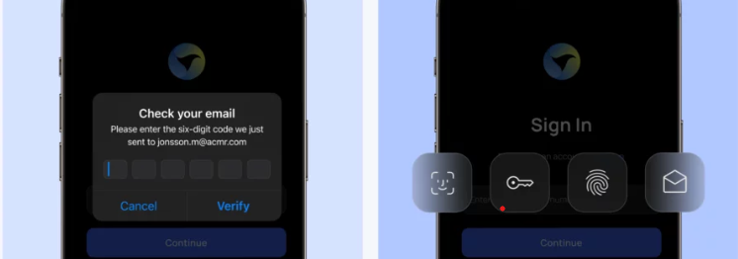
Different Between 2FA And MFA

Slide 11
Which is best to Use
Generally, MFA (Multi-Factor Authentication) is considered more secure than 2FA (Two-Factor Authentication) because it allows for multiple authentication factors, offering a higher level of protection against unauthorized access

Slide 12
What Is Two-Factor Authentication (2FA)?
Two-factor authentication (2FA) is a security protocol that requires two distinct forms of identification before allowing access to a particular system or data. Typically, it adds one more layer of protection to traditional password-only authentication.
The two factors in 2FA can be a combination of something you know (like your password), something you have (such as a physical token or your smartphone), or something you are (biometrics like fingerprints or facial recognition). For instance, when you log into your email account, you might be asked to enter a password and then confirm your identity through a code sent to your mobile phone.

Slide 13
Thank You

